Slide 1
ECE 513 Project
Traffic Sign Detection
and Classification
By Ram Rohit Gannavarapu

Slide 2

Color Based Detection
Converting RGB to HSV color space
HSV(Hue Saturation and Value)
It’s an approximation of human vision

Slide 3
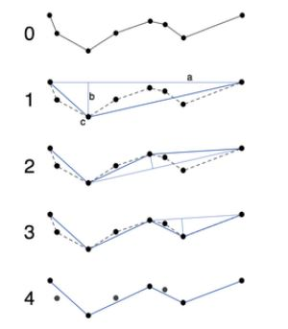
Shape Based Detection
Converting Mask outline to simplified Lines using Ramer-Douglas-Peucker line simplification algorithm
Identify potential shapes based on Circularity and Eccentricity
Create a Region of Interest and feed it to the Machine learning Model.
Ramer-Douglas-Peucker line simplification algorithm

Slide 4
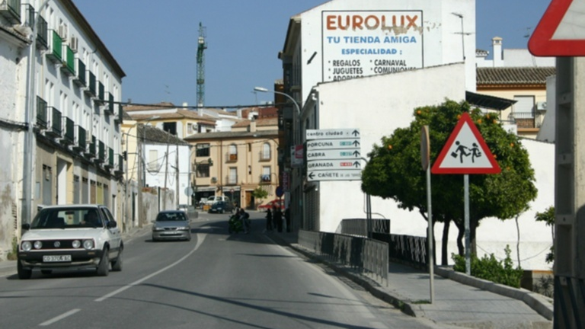
Original Image

Slide 5
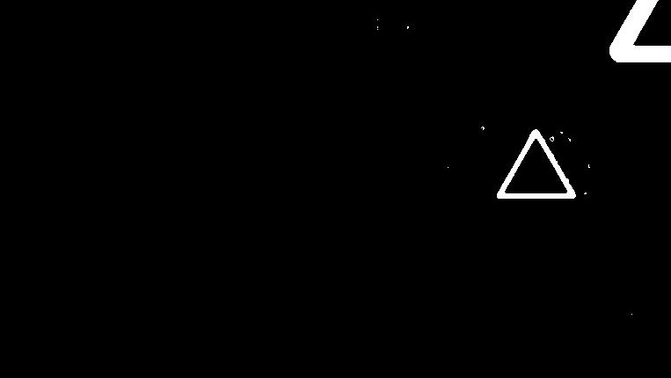
Mask obtained from thresholding colors

Slide 6

Removed Smaller Objects in the mask - bwareaopen

Slide 7

Smoothening the Borders/Edges - imclose

Slide 8

Fill in the holes in the mask – imfill

Slide 9

Masked Image

Slide 10
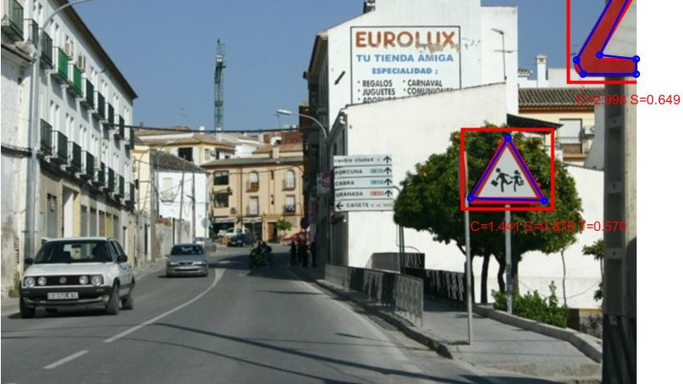
Identified Region of interest

Slide 11
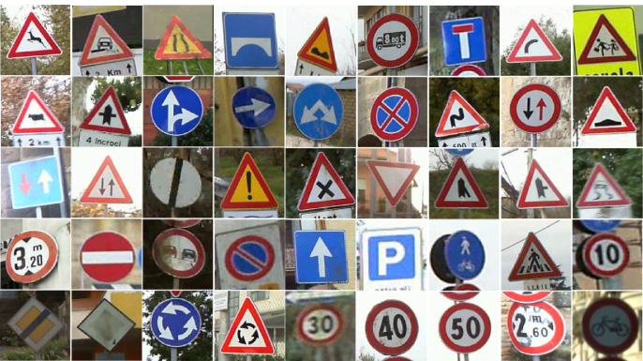
Road Sign Classification
German Traffic Sign Data set
50,000 Images
43 different classes
Image Processing
Gray Scaling
Histogram Equalization
Normalization
Training Machine Learning Model
VGGNet
12 Layers

Slide 12
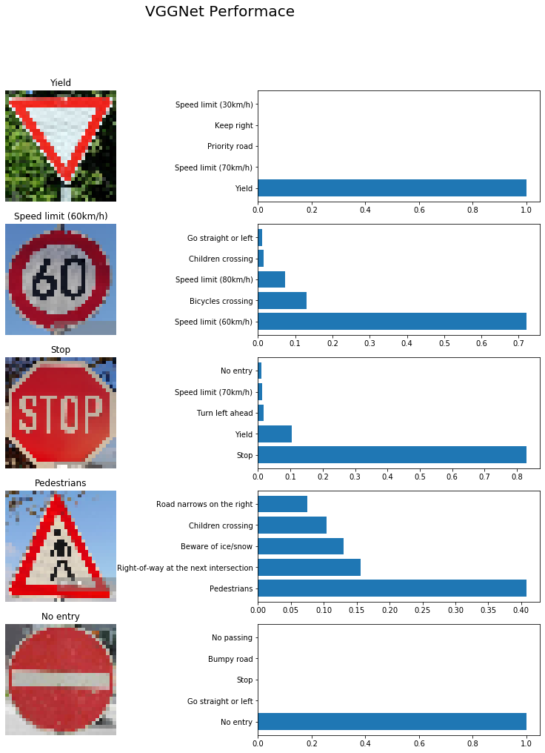
Accuracy
Validation 99.7%
Testing 97.6%

Slide 13
Accuracy

Slide 14
Conclusion
Different lighting conditions affect the thresholding technique and might impact the performance of the system.

